Slide 1
Lecture #8: Secondary Memory
CME2002 Data Organization and Management
Dr.Adil Alpkocak

Slide 2
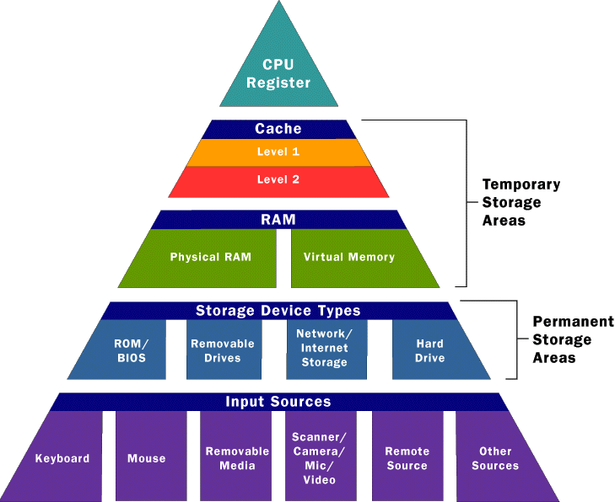

Slide 3
Forms of Electronic Memories
Hard disk drive
Transistor-based semiconductor memories

Slide 4
Types of Electronic Memories
Volatile (temporary)
Non-volatile (semiperminant)

Slide 5
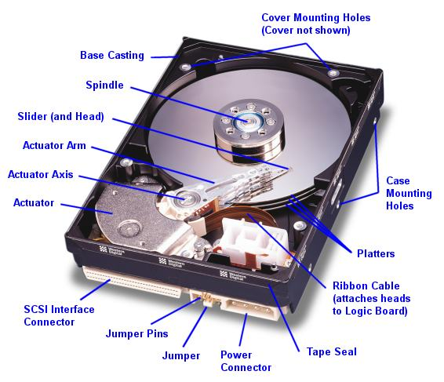
Hard-Disk Drive

Slide 6
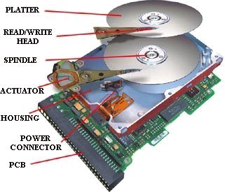
Exploded View of a Hard Drive
Notes:
This exploded view shows the various components inside a typical hard drive.
A hard drive may have more than one platter.
The drive may have more than 2 sides (heads).
All the read/write heads move together.
Sides (heads) start numbering at zero (0).

Slide 7
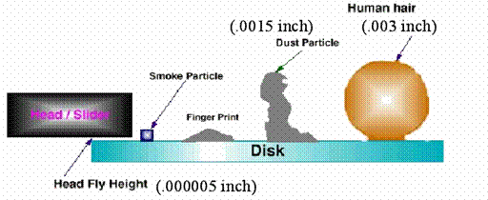
HD Head Clearance
Notes:
The distance between the read/write head and the surface of the hard drive(head fly/floating height) is so small that a strand of human hair will not pass between them.
•Hard drives rotation speed depends on the specific model. Typical speeds are 5,400 RPM, 7,200 RPM, and 10,000 RPM.
•Hard drives were originally coated with ferrous oxide (rust), similar to the coating on audio tapes. Modern drives have some form of “thin film magnetic media”, which allows for closer placement of the read/write heads and allowing more data to be written to the disk (areal density).

Slide 8
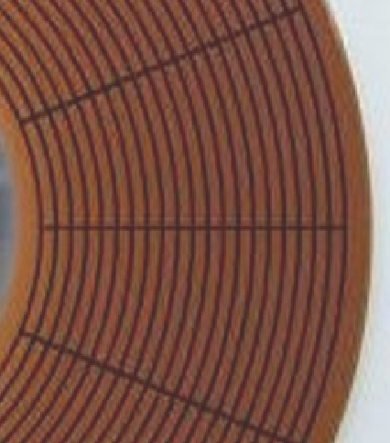
Sector
A sector is a continuous linear stream of magnetized bits occupying a curved section of a track.
Sectors are the smallest physical storage units on a disk- Each sector stores 512 bytes of data
Numbering physical sectors within a track starts with 1.
Sector 2
Track 0
Sector 1
Track 0

Slide 9
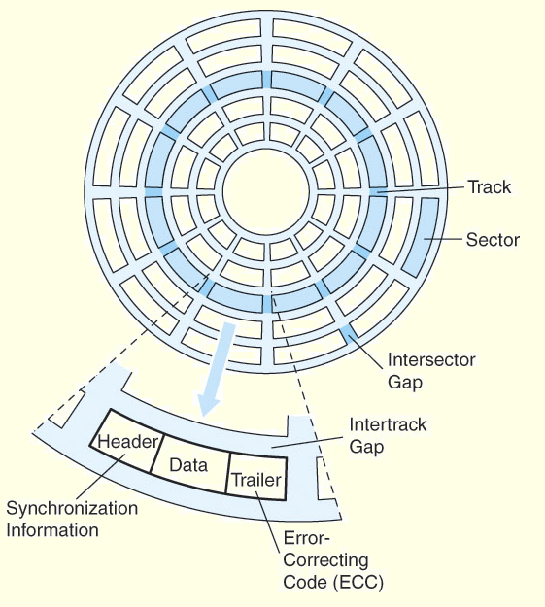
Disk tracks are numbered from the outside edge, starting with zero.

Slide 10
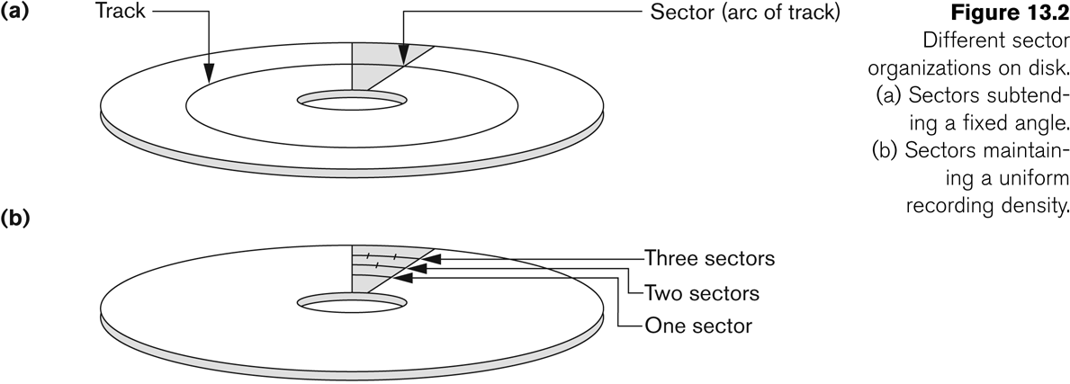
Disk Storage Devices (contd.)

Slide 11
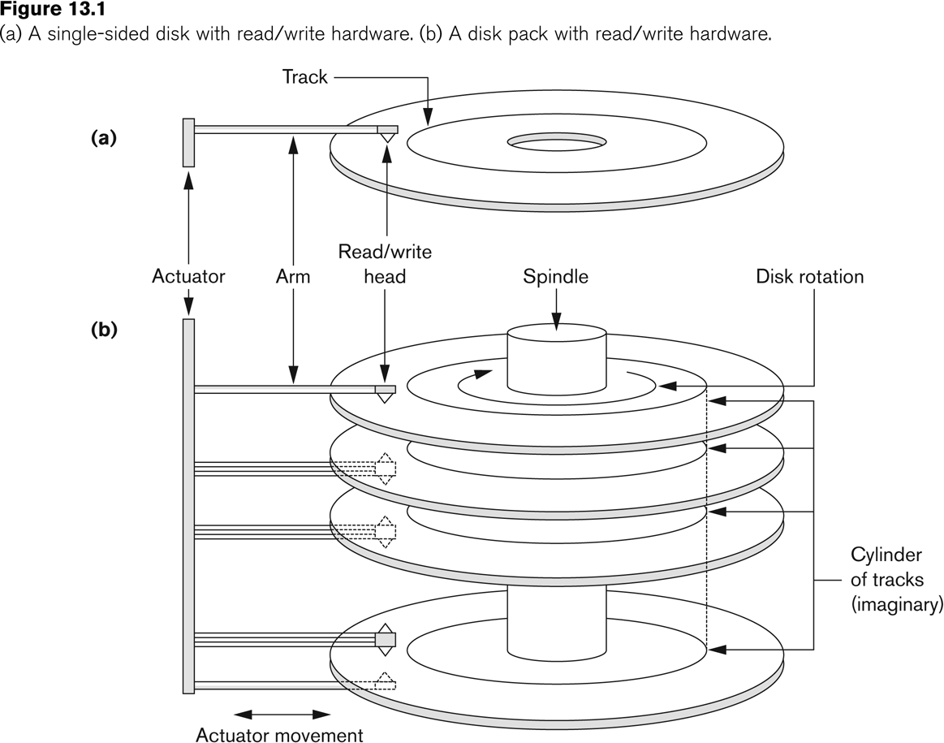
Disk Storage Devices (contd.)

Slide 12
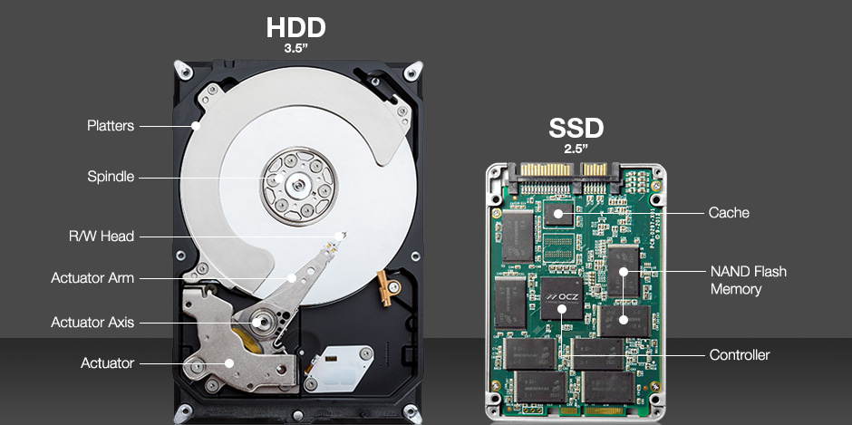
HD vs Solid State Disk (SSD)
Notes:
Solid-state physics is the study of rigid matter, or solids, through methods such as quantum mechanics, crystallography, electromagnetism, and metallurgy.
It is the largest branch of condensed matter physics. Solid-state physics studies how the large-scale properties of solid materials result from their atomic-scale properties. Thus, solid-state physics forms a theoretical basis of materials science.
It also has direct applications, for example in the technology of transistors and semiconductors.

Slide 13
SSD: Advantages over HDDs
Fast read speeds - 2-3x faster than modern desktop HDDs (7,200 RPM using SATA2 interface).
Sustained read speeds - no decrease in read speed across the entirety of the device.
Minimal access time - approximately 100x faster than an HDD. For example, 0.1 ms (100 μs) vs. 12-20 ms (12,000-20,000 μs) for desktop HDDs.
High degree of reliability.
No moving parts.
Minimal heat production.
Minimal power consumption Light-weight - ideal for laptops.
Notes:
. HDD performance tapers off as the drive heads move from the outer edges to the center of HDD platters
- fractions of a W at idle and 1-2 W while reading/writing vs. 10-30 W for a HDD depending on RPMs.

Slide 14
SSD Advantages
Read and Write data much faster than traditional hard disks
Allow PCs to boot up and launch programs far more quickly.
More physically robust
Use less power and generate less heat

Slide 15
SSD: Disadvantages
Lower capacity than most hard disks
Higher storage cost per gigabyte
Limited number of data write cycles
Performance degradation over time
Require appropriate configuration and management to maximize lifespan

Slide 16
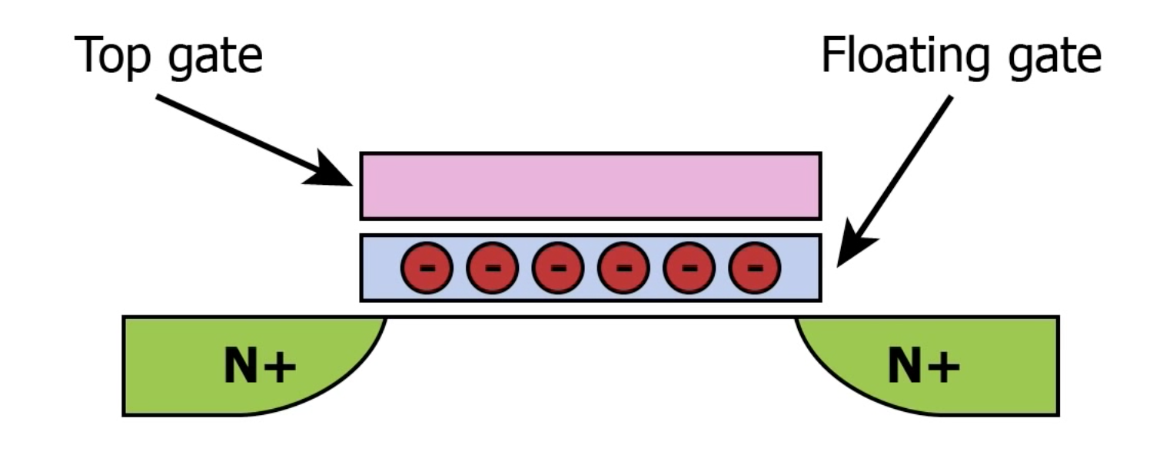
Floating Gate Flash Memory
Notes:
SSD stores bits of data by trapping or release electrons in the floating-gate transistors that cpmprise their flash memory cells

Slide 17
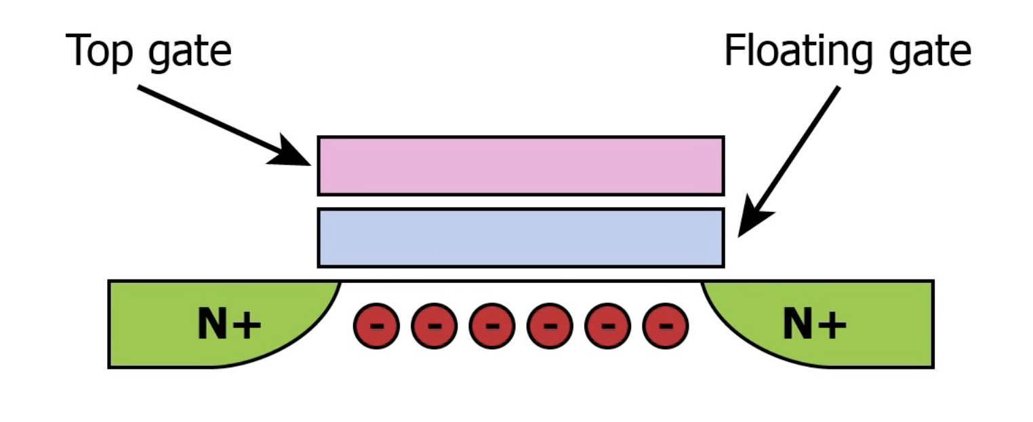
Floating Gate Flash Memory

Slide 18
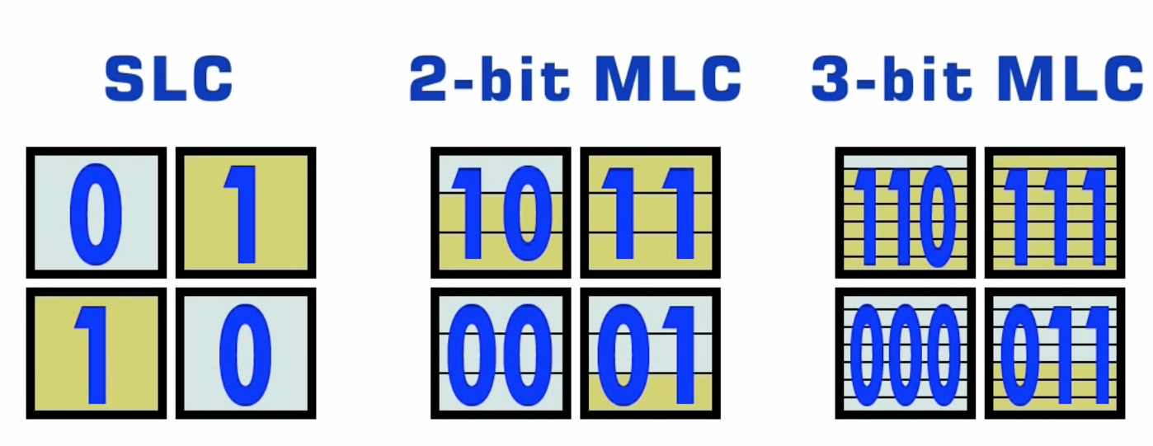
Level cell vs Multi-level cell
Faster
Cheaper
Small Capacity
Slower
Expensive
Large Capacity
Notes:
First SSDs use single level cell or SLC technology but stores one bit of data per cell. However virtually all modern SSDs uses a multilevel cell MLC technology that

Slide 19
SDD: Limitations
Per-storage cost (close to a dollar per GB, vs. around a dime or two per GB for rotating media).
Low Capacity.
Large cells require different filesystem optimizations than rotating media.
Cells wear out.
Performance can drop as the disk gets filled. Garbage collection is not universally well implemented!
Notes:
Per-storage cost (close to a dollar per GB, vs. around a dime or two per GB for rotating media).
Capacity of marketed models is lower than that of HDDs.
Large cells require different filesystem optimizations than rotating media. The flash translation layer hides the raw flash access which a modern OS could use to optimize access.
Partitions and filesystems need some SSD-specific tuning. Page size and erase page size are not autodetected.
Cells wear out. Consumer MLC cells at mature 50nm processes can handle 10000 writes each; 35nm generally handles 5000 writes, and 25nm 3000 (smaller being higher density and cheaper). If writes are properly spread out, are not too small, and align well with cells, this translates into a lifetime write volume for the SSD that is a multiple of its capacity. Daily write volumes have to be balanced against life expectancy. However, tests [1][2][3][4] performed on recent hardware suggest that SSD wear is negligible, with the lifetime expectancy of SSDs comparable to those of HDDs even with artificially high write-volumes.
Firmwares and controllers are complex. They occasionally have bugs. Modern ones consume power comparable with HDDs. They implement the equivalent of a log-structured filesystem with garbage collection. They translate SATA commands traditionally intended for rotating media. Some of them do on the fly compression. They spread out repeated writes across the entire area of the flash, to prevent wearing out some cells prematurely. They also coalesce writes together so that small writes are not amplified into as many erase cycles of large cells. Finally they move cells containing data so that the cell does not lose its contents over time.
Performance can drop as the disk gets filled. Garbage collection is not universally well implemented, meaning freed space is not always collected into entirely free cells.

Slide 20
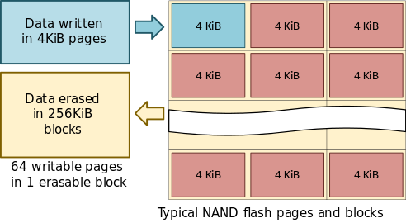
Due to the nature of flash memory's operation, data cannot be directly overwritten as it can in a hard disk drive. When data is first written to an SSD, the cells all start in an erased state so data can be written directly using pages at a time (often 4–8 kilobytes (KB) in size).

Slide 21
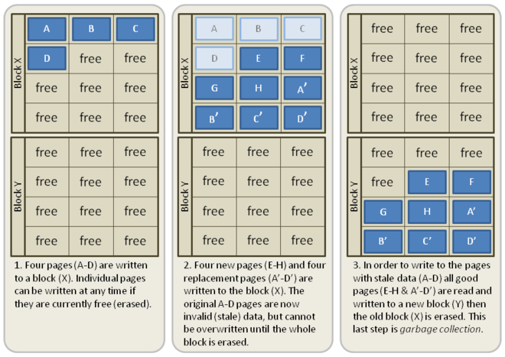
Garbage Collection in SSD

Slide 22
Types of Memory Access
Random Access
items are independently addressed
access time is constant
Direct Access
items are independently addressed in regions
access time is variable—though not significantly
Sequential Access
items are organized in sequence (linearly)
access time is significantly variable

Slide 23
File Reading
Two types of File Reading
Sequential
Random Reading

Slide 24
File I/O Support in C and C++
Generally, C and C++ support three kinds of file I/O commands:
Low level (Posix),
C streams, and
C++ streams
Notes:
We will discuss in lab session.

Slide 25
Cost of Disk Accesses

Slide 26
Cost of Reading
Cost of Reading = s + r + btt
seek time (s) : the time required to move the access arm to the correct cylinder
Rotational Delay (r) : average time it takes to locate the correct block on a track once the head is on the correct track
Block transfer time (btt): the time it takes to transfer the information in one block on the disk to memory

Slide 27
Parameters for the IBM 3380
parameter definition value
B block size 2400 bytes
btt block transfer time 0.8 ms = B / t
C blocks per cylinder 600
ebt effective block transfer time 0.84 ms = B / t'
m minimum seek time 3 ms
N number of cylinders 885 (per spindle)
r average rotational latency 8.3 ms
s average seek time 16 ms
t speed 3.000 bytes/ms
t' formatted speed 2857 bytes/ms

Slide 28
Searching Sequential Files
To look-up a record, given the value of one or more of its fields, we must search the whole file.
In general, (b is the total number of blocks in file):
At least 1 block is accessed
At most b blocks are accessed.
On average 1/b * b (b + 1) / 2 => b/2
Thus, time to find and read a record in a pile file is approximately : T_{F} = (b/2) * btt
Time to fetch one record
Block transfer time

Slide 29
File Operations
Typical Operations
T_{x} = Exhaustive reading time
T_{F} = Fetching one record
T_{N} = Fetching next record in order
T_{I} = Inserting a new record
T_{D} = Delete a record
T_{U} = Update a records by modifying values
T_{Y} = Time to reorganization of a file

Slide 30
Exhaustive Reading of the File
Read and process all records (reading order is not important)
T_{X} = s + r + b * btt
T_{X} = b * btt
(approximately twice the time to fetch one record)
e.g. Finding averages, min or max, or sum.
Pile file is the best organization for this kind of operations.

Slide 31
Fetching the Next Record
Since the record in a pile file are not stored in order;
T_{N} = T_{F}
T_{x} = 2T_{F}

Slide 32
Inserting a New Record
Time needed is that for modifying a block, given its adress.
T_{I} = s + r + btt + 2r
We assume that
We put the new record at the end of the file
No particular order is required

Slide 33
Deleting a Record
We modifiy the record by placing a special mark on the deleted record.
T_{D} = T_{F} + 2r
btt
r
r-btt

Slide 34
Modifying a Record
Time to find and modify a record in a file of fixed-length record.
T_{U} = T_{F} + 2r
In variable-length records;
T_{U} = T_{F} + 2r + T_{I}
btt
r
r-btt

Slide 35
Parameters for the IBM 3380
parameter definition value
B block size 2400 bytes
btt block transfer time 0.8 ms = B / t
C blocks per cylinder 600
ebt effective block transfer time 0.84 ms = B / t'
m minimum seek time 3 ms
N number of cylinders 885 (per spindle)
r average rotational latency 8.3 ms
s average seek time 16 ms
t speed 3.000 bytes/ms
t' formatted speed 2857 bytes/ms

Slide 36
Block, Record, Bucket
1 block
1 block
1 record
1 record
1 record
1 bucket

Slide 37
Cost of Sequential Reading

Slide 38
1. Sequential files
Records are stored contiguously on the storage device.
Sequential files are read from beginning to end.
Some operations are very efficient on sequential files (e.g. finding averages)
Organization of records:
Unordered sequential files (pile files)
Sorted sequential files (records are ordered by some field)

Slide 39
Unordered Files
Also called a heap or a pile file.
New records are inserted at the end of the file.
A linear search through the file records is necessary to search for a record.
This requires reading and searching half the file blocks on the average, and is hence quite expensive.
Record insertion is quite efficient.
Reading the records in order of a particular field requires sorting the file records.

Slide 40
Ordered Files
Also called a sequential file.
File records are kept sorted by the values of an ordering field.
Insertion is expensive: records must be inserted in the correct order.
A binary search can be used to search for a record on its ordering field value.
This requires reading and searching log₂ # of the file blocks on the average, an improvement over linear search.
Reading the records in order of the ordering field is quite efficient.

Slide 41
Sequential Reading
Ordered File
Ahmet, Çiçek, 9876
Beyhan, Kaya, 3456
Ali, Veli, 1234
Birol, Karanfil, 3453
1
Read Block 1
Process the records
Read block #2
Process the records
Read block #3
Process the records
...
Read block #b
Process the records
Canan, Kara, 3456
Cumhur, duru, 4567
Erhan, Aktepe, 9087
Derya, Tuna, 5678
2
Kemal, Güçlü, 4563
Meral, Konak, 1289
Nermin, Akyol, 4567
Nilgün, Tepe, 1298
3
…
Tahir, Doğru, 3412
Vedat, Kuru, 3497
Zeki, Yetkin, 7654
Zikri, Laçin, 9876
b

Slide 42
Sequential Reading
Unordered File
Ali, Veli, 1234
Erhan, Aktepe, 9087
Meral, Konak, 1289
Zeki, Yetkin, 7654
1
Read block #1, process records
Read block #2, process records
Read block #3, process records
...
Read block #b, process records
Canan, Kara, 3456
Derya, Tuna, 5678
Birol, Karanfil, 3453
Zikri, Laçin, 9876
2
Kemal, Güçlü, 4563
Beyhan, Kaya, 3456
Nermin, Akyol, 4567
Nilgün, Tepe, 1298
3
…
Tahir, Doğru, 3412
Vedat, Kuru, 3497
Cumhur, duru, 4567
Ahmet, Çiçek, 9876
n

Slide 43
Sequential Reading
Case #1: if 10 blocks are adjacent
= s + r + 10 * ebt
= 16 + 8.3 + 8.4
= 32.7 ms

Slide 44
Sequential Reading
Case #2: if 10 blocks are placed randomly on disk
= 10 * (s + r + ebt)
= 10 * (16 + 8.3 + 0.8)
= 10 * 25.1
= 251 ms

Slide 45
Sequential Reading
Case #1: if 100 blocks are adjacent
= s + r + 100 * ebt
= 16 + 8.3 + 100 * 0.84
= 108.3 ms = 0.1083 sec
= 24.3 + b * 0.84

Slide 46
Sequential Reading
Case #2: if 100 blocks are placed randomly on disk
= 100 * (s + r + ebt)
= 100 + (16 + 8.3 + 0.8)
= 100 * 25.1
= 2510 ms = 2.510 sec
= b * 25.1

Slide 47
Sequential Reading
“Random case is 30 times as large as the consecutive case”

Slide 48
Blocking Factor
Bfr = B / R
B : # of bytes in a block
R : # of bytes in a record
Example
B = 2400 R = 100
Bfr = 2400 / 100 = 24 records per block

Slide 49
Blocking Factor
If R does not evenly divide the B we have two choices:
Overlap records accros block boundaries
Leave some empty space in each block
Hint: choose record sizes evenly divide the block size

Slide 50
Blocking factor
Example:
n : The number of record in a file
b = n / Bfr, total number of blocks in a file
Time to read the file sequentially from beginning to end is equal to:
b x ebt = ( n / Bfr ) x ebt

Slide 51
Affects of Blocking Factor to Sequential Reading
Example:
n = 30 000, R=1600, B=2400
Case #1:
Bfr = = 2400 / 1600 = 1
= (n/Bfr) * ebt
= 30000 * 0.84
= 25200 = 25.2 sec

Slide 52
Affects of Blocking Factor to Sequential Reading
Example:
n = 30 000, R=1600, B=2400
Case #2:
Bfr = B / R = 2400 / 1600 = 3/2
= (n/Bfr) * ebt
= (30000/(3/2)) * 0.84
= 16.8 sec

Slide 53
Affects of Blocking Factor to Sequential Reading
25.2 sec versus 16.8 sec
“Sequential reading time depends on the amount of space the file takes up”

Slide 54
Cost of Random Reading
Random Reading
RR by bucket
RR by record

Slide 55
Random Reading By Bucket
Ordered File
Ahmet, Çiçek, 9876
Beyhan, Kaya, 3456
Ali, Veli, 1234
Birol, Karanfil, 3453
1
Read Bucket #215, process records
Read bucket #23, process records
Read bucket #8, process records
Read bucket #67, process records
…
Tx = bk x (r + s + dtt)
Typical range query
Canan, Kara, 3456
Cumhur, duru, 4567
Erhan, Aktepe, 9087
Derya, Tuna, 5678
2
Kemal, Güçlü, 4563
Meral, Konak, 1289
Nermin, Akyol, 4567
Nilgün, Tepe, 1298
3
…
Tahir, Doğru, 3412
Vedat, Kuru, 3497
Zeki, Yetkin, 7654
Zikri, Laçin, 9876
bk
Notes:
We assume that we have in memory a list of the records in the file and their corresponding bucket address.

Slide 56
Random Reading By Records
Ordered File
Ahmet, Çiçek, 9876
Beyhan, Kaya, 3456
Ali, Veli, 1234
Birol, Karanfil, 3453
1
Read record “Meral”
Read record “Tahir”
Read record “Ahmet”
Read record “Nermin”
Read record “Beyhan”
…
Read record n
Tx = n x (r + s + dtt)
Typical point query
Canan, Kara, 3456
Cumhur, duru, 4567
Erhan, Aktepe, 9087
Derya, Tuna, 5678
2
Kemal, Güçlü, 4563
Meral, Konak, 1289
Nermin, Akyol, 4567
Nilgün, Tepe, 1298
3
…
Tahir, Doğru, 3412
Vedat, Kuru, 3497
Zeki, Yetkin, 7654
Zikri, Laçin, 9876
bk
Notes:
n = number of records

Slide 57
Example
A file, with 30K records of 100 bytes each
Bucket/block size changes 2400-4800 bytes
Goal is to see how different block size affects the reading time.

Slide 58
Do sequential reading
Case #1: Bucket size = 2400 bytes
bk = b = R/Bfr = 30000/24 = 1250 buckets
T_{x}= b x dtt = 1250 x 0.84 ≅ 1 sec
Case #2: Bucket size = 4800 bytes
bk = R / Bfr = 30000/48 = 625 buckets
T_{x}= b x dtt = 625x 1.68≅ 1 sec
“Bucket size does not affect sequential reading time”

Slide 59
Random Reading by records
Tx = n x ( s + r + dtt)
Case #1: bucket size = 2400
30000 x (16 + 8.3 + 0.84) = 754 sec
Case #2: bucket size = 4800
30000 x (16 + 8.3 + 1.64) = 778 sec
“Larger bucket size makes random reading by records less efficient”

Slide 60
Random Reading by buckets
Tx = bk x ( s + r + dtt)
Case #1: bucket size = 2400
1250 x (16 + 8.3 + 0.84) ≅ 31 sec
Case #2: bucket size = 4800
625 x (16 + 8.3 + 1.64) = 16 sec
“Larger bucket size makes random reading by bucket more efficient”

Slide 61
Optimum bucket size for mix operation
For a month;
we do 1000 individual record fetches
1000 × (s + r + dtt)
We read the whole file randomly by bucket
bk × ( s + r + dtt)
Total cost = (bk+1000) × (s+r+dtt)

Slide 62
Optimum bucket size for mix operation
Let us assume, X represents size
dtt = X / t = X / 2857
bk = file size / X = (3000×100) / X
Total cost = (bk+ 1,000) x (s+r+dtt)
= (3000000/X + 1,000) × ( 24.3 + X/2587)
= constant+(24.3×3,000,000)/ X +(1,000×X )/2587
Take derivative respect to X and equalize to zero and solve the equation
= 0 + (-a / X² ) + 1,000/2587
≈ 13671
X ≈ 14440 bytes (6×2,400)

Slide 63
Summary
Larger bucket size makes random reading by bucket more efficient.
Larger bucket size makes random reading by records less efficient.
Bucket size does not affect sequential reading time.

